Slide 1
Electronic System

Slide 2
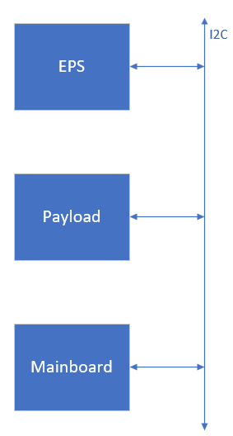
Power Distribution and Communication

Slide 3
Mainboard

Slide 4
Payload

Slide 5
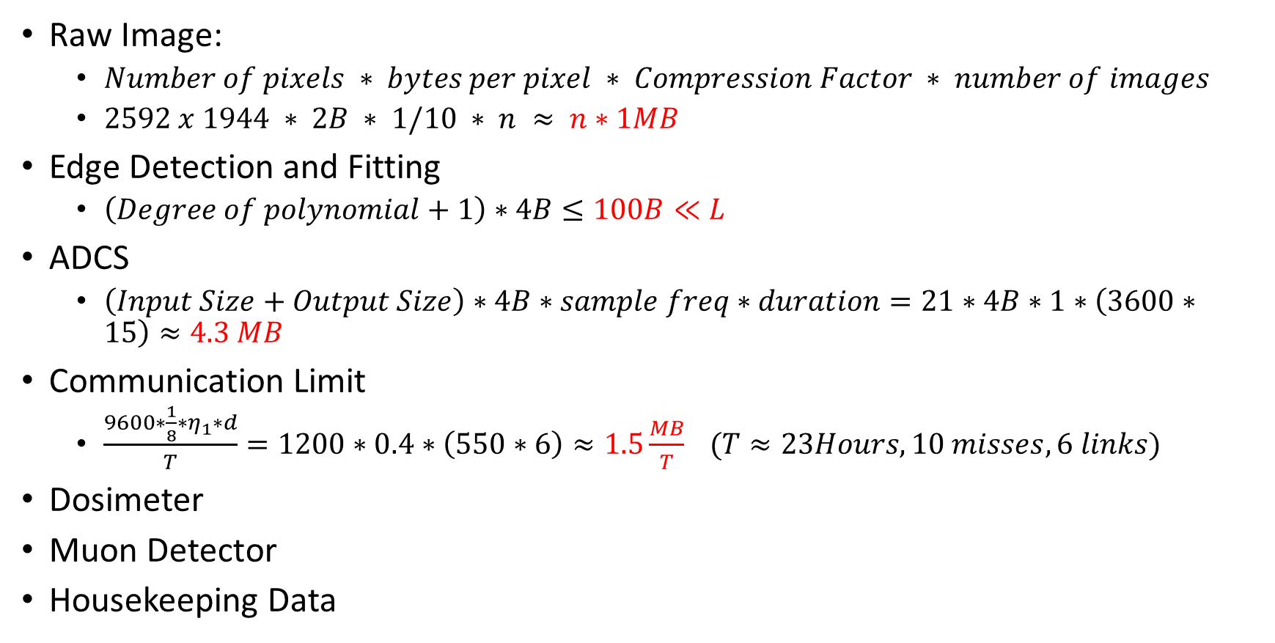
Memory and Communication
Raw Image:
$Number of pixels ∗ bytes per pixel ∗ Compression Factor ∗ number of images$
$2592 x 1944 ∗ 2B ∗ 1/10 ∗ n ≈ n∗1MB$
Edge Detection and Fitting
$\left(Degree of polynomial+1\right)∗4B≤100B≪L$
ADCS
$\left(Input Size+Output Size\right)∗4B∗sample freq∗duration=21∗4B∗1∗\left(3600∗15\right)≈4.3 MB$
Communication Limit
$\frac{9600∗\frac{1}{8}∗η_{1}∗d}{T}=1200∗0.4∗\left(550∗6\right)≈1.5\frac{MB}{T} (T≈23Hours, 10 misses, 6 links)$
Dosimeter
Muon Detector
Housekeeping Data

Slide 6
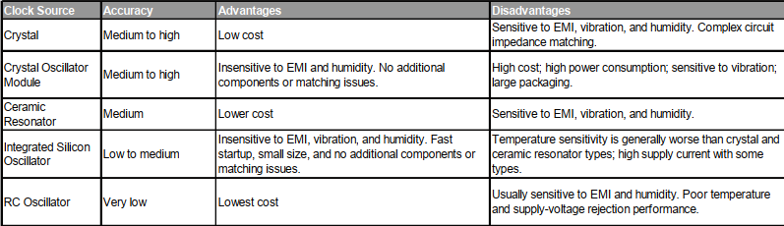
Clock
[1] Swisscube Phase B OBC report

